Slide 1

LACE MODEL
Benjamin Tate & Gareth Harman
Notes:
Were here to talk about risk score and predictive model for 30 day patient readmission

Slide 2
IMPACT
PRESENT
READMITS COSTLY
SUBJECTIVITY
PREDICTIVE MODELING
FUTURE
PENALIZED READMISSION
PATIENT SATISFCATION
OUTCOME
Notes:
- Predictive modeling may strengthen maturity level of institution

Slide 3
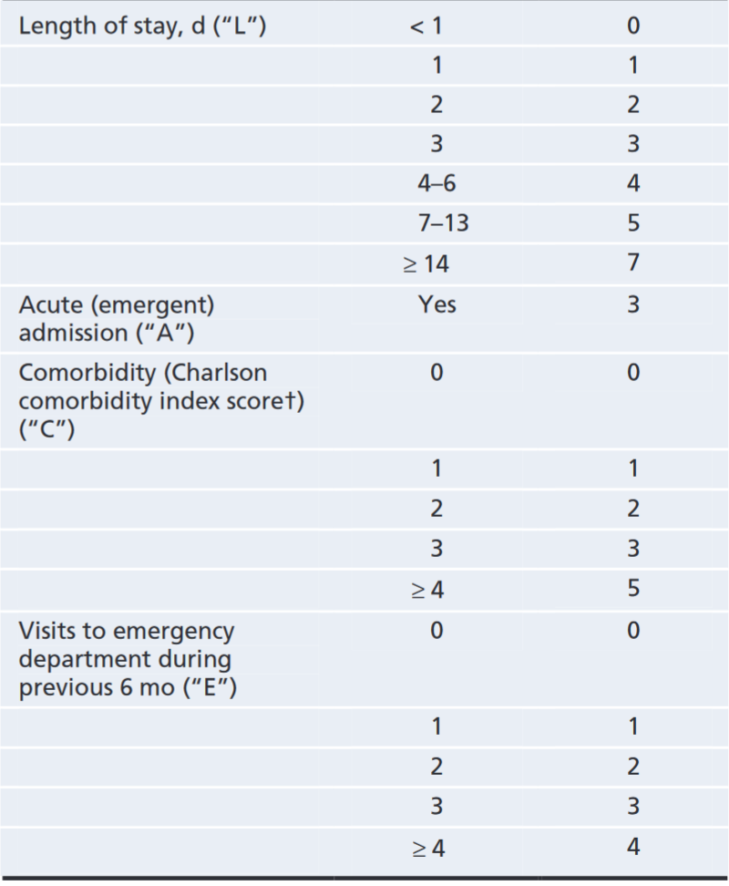
Walraven et al. 2010
Length of Stay
Visit to the emergency room (6 mo)
L
LACE
A
E
Acute Emergent Admission
Comorbid
C
Notes:
There are other models that exist but they require neighborhood, community, SES specific info
Easily digestible / interpretable as an aggregate of a lot of information

Slide 4
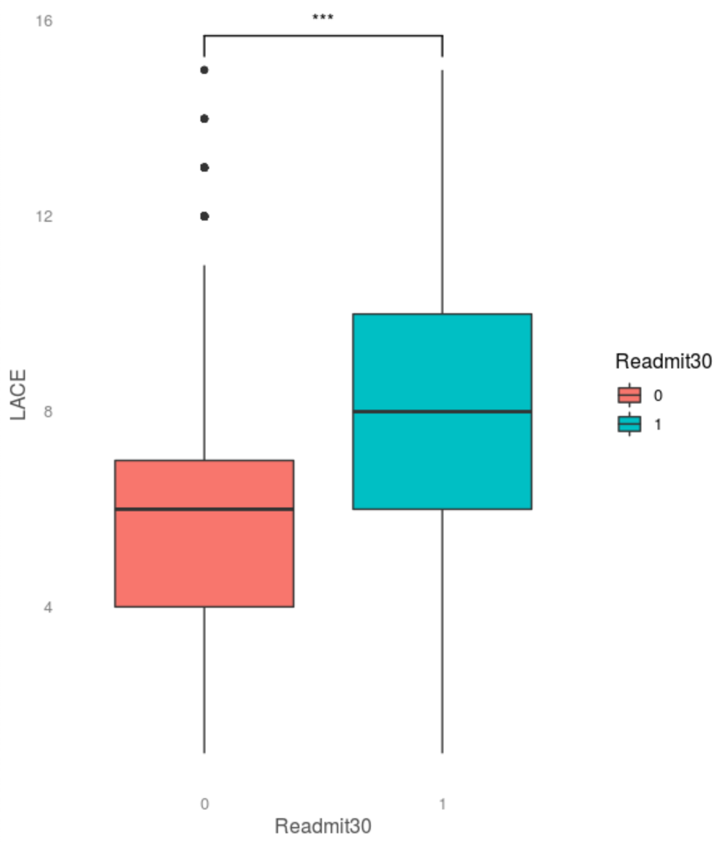
LACE
LACE
Aggregate summary score of 50 features
Components are reliable metrics
Easily digestible / interpretable
Derived from valid and transparent methods
Does not require geographic or SES data
Significant LACE interaction (p < .001) in our data

Slide 5
PREDICTIVE MODELING
Can we use the LACE score to predict readmission within 30 days?
How do we assess success?
Best metric to assess performance?
Sensitivity (TP)
Reduce negative patient outcome
May be unnecessarily making patients come back in
Specificity (TN)
Patient not coming in unnecessarily
Not over-burdening physicians
May miss patients that need to come in
There are pros/cons to either

Slide 6
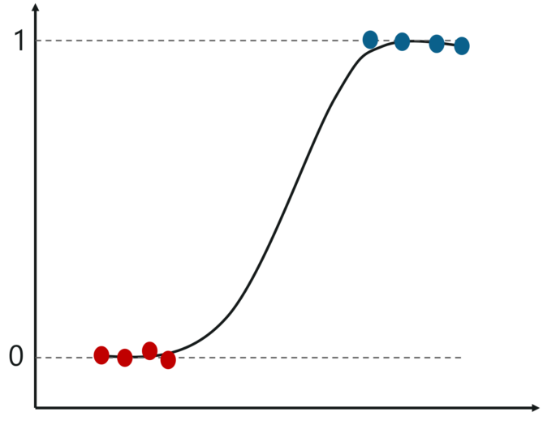
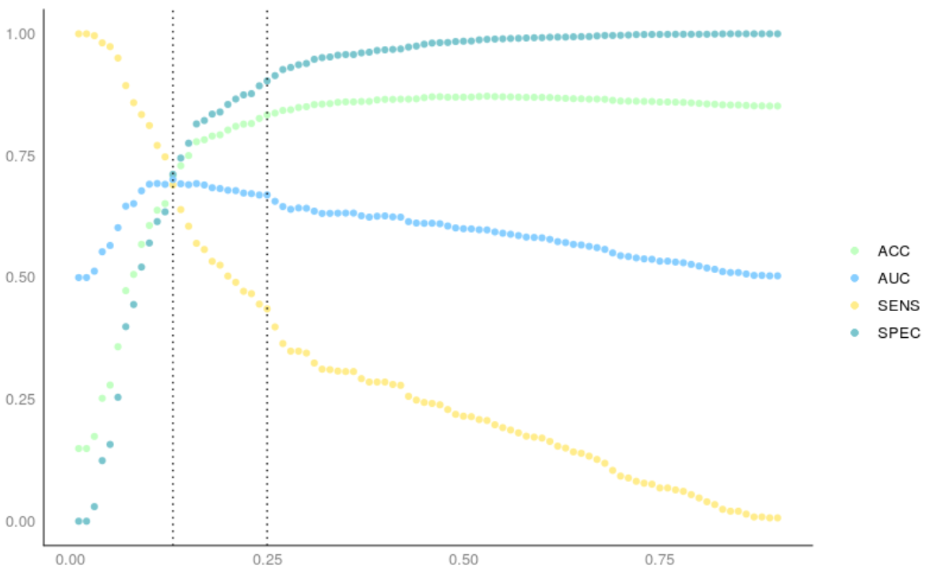
LOGISTIC REGRESSION
ACCURACY
.84
SENSITIVTY
.44
Readmit30
SPECIFICITY
.92
AUC
.67
LACE
Credit: edureka

Slide 7
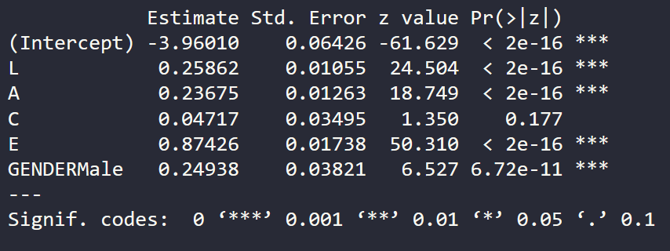
LOGISTIC REGRESSION

Slide 8
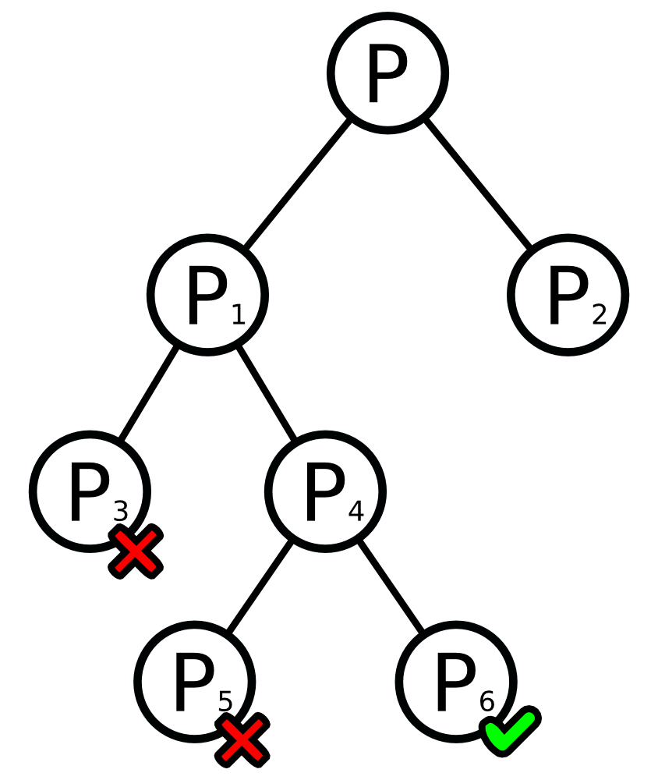
CART
ACCURACY
.86
SENSITIVTY
.10
SPECIFICITY
.99
AUC
.55

Slide 9
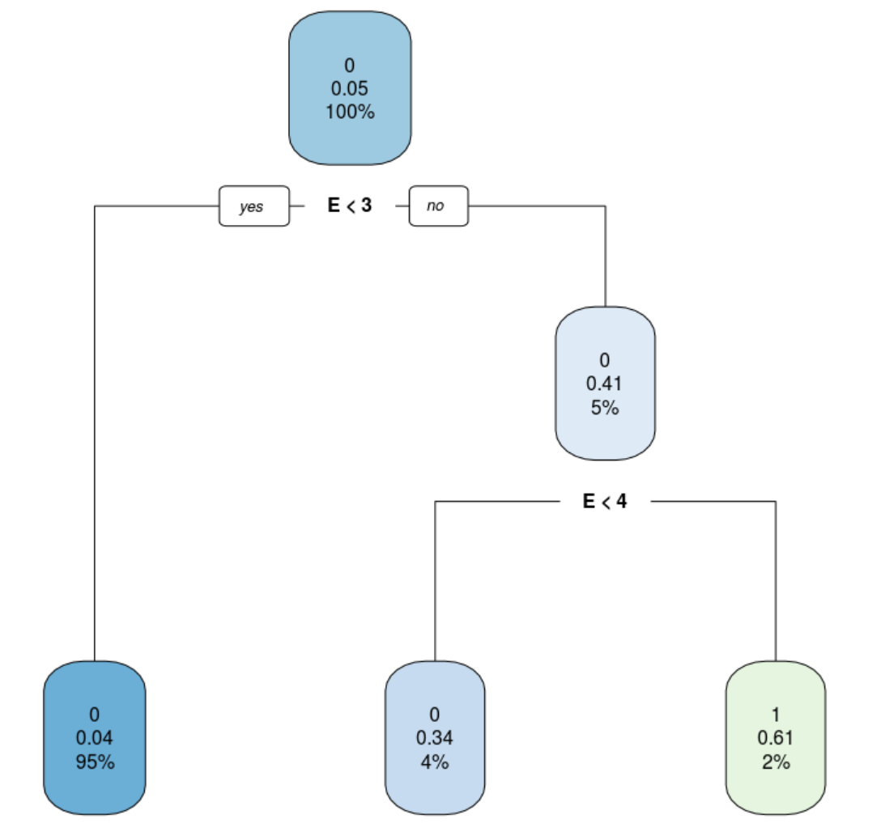
CART

Slide 10
How will it look?
Metrics and model will be incorporated into the EHR
Very little additional time and effort would be required
Risk would be automatically predicted and immediately available to physicians/nurses
Risk category could contribute to automatically suggested plans of action for post-discharge care
Tangible impacts:
Improved patient outcome and satisfaction
Save hospital and patients money

Slide 11
Next steps
To move forward, we need resources
Including more than two comorbidities will likely improve predictive power
As we expand to more hospitals, we will get more data
Improve predictive power and advance the organization’s analytic maturity
Expansion:
Expand incrementally by region
May find more predictors as we expand, improving accuracy even further
Expansion will improve overall impact and public reception
Upkeep:
Costs to maintain will be minimal
Model will learn continually

Slide 12
THANK YOU

